Slide 1
WELCOME TO THE
LONDON CLUB WINE SHOP

Slide 2
WELCOME TO THE
LONDON CLUB WINE SHOP

Slide 3
WELCOME TO THE
LONDON CLUB WINE SHOP

Slide 4
WELCOME TO THE
LONDON CLUB WINE SHOP

Slide 5
WELCOME TO THE
LONDON CLUB WINE SHOP

Slide 6
WELCOME TO THE
LONDON CLUB WINE SHOP

Slide 7
WELCOME TO THE
LONDON CLUB WINE SHOP

Slide 8
MEMBERS FAVOURITES
REDS
< HOME

Slide 9
MEMBERS
FAVOURITES
REDS
BIBI GRAETZ
TUSCANY, ITALY
DUCKHORN
CALIFORNIA, USA
TEXTBOOK
CALIFORNIA, USA
RIDGE
CALIFORNIA, USA
ANTINORI
TUSCANY, ITALY
CADE
CALIFORNIA, USA
JOSEPH PHELPS
CALIFORNIA, USA
< HOME

Slide 10
MEMBERS
FAVOURITES
1 bottle
$38
6 bottles
$228
12 bottles
$456
REDS
BIBI GRAETZ
TUSCANY, ITALY
DUCKHORN
CALIFORNIA, USA
TEXTBOOK
CALIFORNIA, USA
RIDGE
CALIFORNIA, USA
BIBI GRAETZ, CASAMATTA, ROSSO, TUSCANY, ITALY
ANTINORI
TUSCANY, ITALY
CADE
RED CASAMATTA COMES FROM THE YOUNGER VINEYARDS OF THE COMPANY, FROM SANGIOVESE GRAPES. TRADITIONAL IN ITS COMPLEXITY AND ROUNDNESS, BUT MODERN IN ITS FRUITY TASTE, IN ITS ACCESSIBILITY AND TANNIC SOFTNESS, IT IS CHARACTERIZED BY A YOUNG AND CRUNCHY, HIGHLY DRINKABLE PROFILE.
CALIFORNIA, USA
JOSEPH PHELPS
CALIFORNIA, USA
< HOME

Slide 11
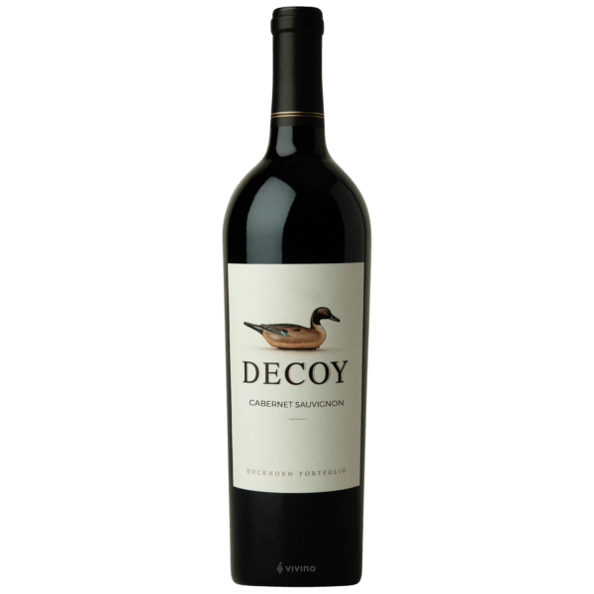
MEMBERS
FAVOURITES
1 bottle
$48
6 bottles
$288
12 bottles
$576
REDS
BIBI GRAETZ
TUSCANY, ITALY
DUCKHORN
CALIFORNIA, USA
TEXTBOOK
CALIFORNIA, USA
RIDGE
CALIFORNIA, USA
ANTINORI
DUCKHORN, DECOY, CABERNET SAUVIGNON, SONOMA COUNTY, CALIFORNIA
TUSCANY, ITALY
CADE
CALIFORNIA, USA
MEDIUM-BODIED CABERNET WITH A FRUITY AND SPICY NOSE AND TANGY TASTING NOTES OF BLACKBERRY, PLUM, AND CHOCOLATE WITH A SMOOTH AND SMOKY FINISH.
JOSEPH PHELPS
CALIFORNIA, USA
< HOME

Slide 12
MEMBERS
FAVOURITES
1 bottle
$70
6 bottles
$420
12 bottles
$840
REDS
BIBI GRAETZ
TUSCANY, ITALY
DUCKHORN
CALIFORNIA, USA
TEXTBOOK
CALIFORNIA, USA
RIDGE
CALIFORNIA, USA
TEXTBOOK, CABERNET SAUVIGNON,
NAPA VALLEY, CALIFORNIA
ANTINORI
TUSCANY, ITALY
CADE
OPENS WITH DARK FRUIT AROMATICS OF BLACK CURRANT AND PLUM. AMPLE OAK FLAVOURS ARE LAYERED AND SUMPTUOUS ACROSS THE MID-PALATE. THE FINISH IS STRUCTURED AND BALANCED WITH BIG SUPPLE TANNINS – THE CLASSIC NAPA VALLEY ‘TEXTBOOK’ STYLE OF CABERNET SAUVIGNON.
CALIFORNIA, USA
JOSEPH PHELPS
CALIFORNIA, USA
< HOME

Slide 13
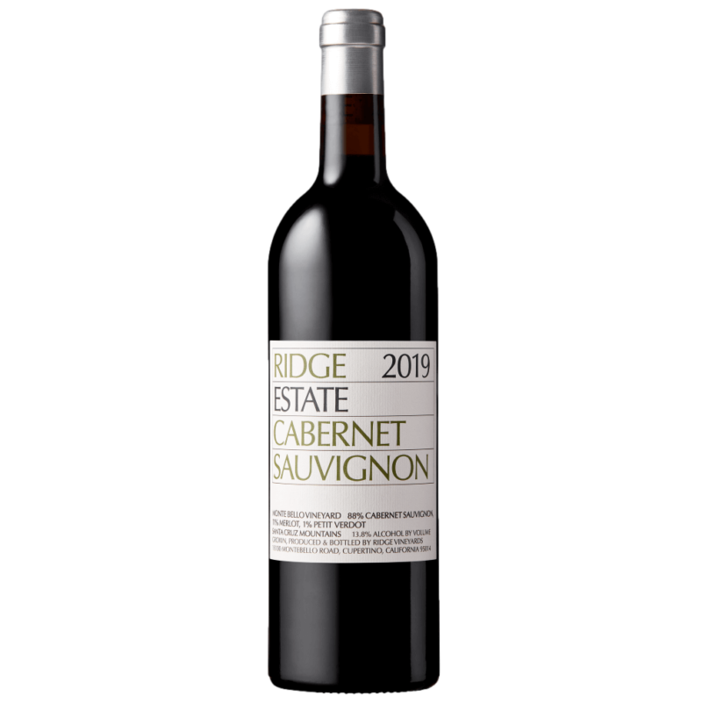
MEMBERS
FAVOURITES
1 bottle
$180
6 bottles
$1080
12 bottles
$2160
REDS
BIBI GRAETZ
TUSCANY, ITALY
DUCKHORN
CALIFORNIA, USA
TEXTBOOK
CALIFORNIA, USA
RIDGE
CALIFORNIA, USA
RIDGE, ESTATE, CABERNET SAUVIGNON, NAPA VALLEY, CALIFORNIA
ANTINORI
TUSCANY, ITALY
FROM THE ESTATE MONTE BELLO VINEYARD ON THE EASTERN SIDE OF THE SANTA CRUZ MOUNTAINS. 88% CABERNET SAUVIGNON, 11% MERLOT AND 1% PETIT VERDOT. ITS DEEP RUBY/PURPLE COLOUR IS FOLLOWED BY A BRILLIANT PERFUME OF BLUE FRUITS, SCORCHED EARTH, TOBACCO LEAF, AND LEAD PENCIL. BEAUTIFULLY BALANCED AND MEDIUM TO FULL-BODIED, WITH BUILDING TANNINS. 94+ RATING
CADE
CALIFORNIA, USA
JOSEPH PHELPS
CALIFORNIA, USA
< HOME

Slide 14
1 bottle
$220
6 bottles
$1320
12 bottles
$2640
MEMBERS
FAVOURITES
REDS
BIBI GRAETZ
TUSCANY, ITALY
DUCKHORN
CALIFORNIA, USA
TEXTBOOK
CALIFORNIA, USA
RIDGE
ANTINORI, TIGNANELLO, TUSCANY, ITALY
CALIFORNIA, USA
#5 WINE SPECTATOR TOP 100 OF 2022
TIGNANELLO 2019 IS AN INTENSE RUBY RED COLOUR. COMPLEX NOTES OF RED FRUITS GIVE RISE TO DELICATE AROMAS OF APRICOTS AND PEACHES WITH SENSATIONS OF VANILLA, DRIED FLOWERS, CHOCOLATE AND SPICE. ITS BOUQUET IS COMPLIMENTED BY NOTES OF COFFEE, CARAMEL AND MEDITERRANEAN HERBS. ON THE PALATE, THE WINE IS RICH AND VIBRANT WITH SILKY TANNINS. ITS LENGTHY FINISH AND AFTERTASTE BRING BACK COFFEE AND CHOCOLATE NOTES PERCEIVED ON THE NOSE.
ANTINORI
TUSCANY, ITALY
CADE
CALIFORNIA, USA
JOSEPH PHELPS
CALIFORNIA, USA
80% SANGIOVESE, 15% CABERNET SAUVIGNON,
5% CABERNET FRANC.
< HOME

Slide 15
1 bottle
$280
6 bottles
$1680
12 bottles
$3360
MEMBERS
FAVOURITES
REDS
BIBI GRAETZ
TUSCANY, ITALY
DUCKHORN
CALIFORNIA, USA
TEXTBOOK
CALIFORNIA, USA
RIDGE
CADE, ESTATE, CABERNET SAUVIGNON, HOWELL MOUNTAIN, NAPA VALLEY, CALIFORNIA
CALIFORNIA, USA
ANTINORI
TUSCANY, ITALY
AROMAS OF CLOVE, CRANBERRY, RASPBERRY, COFFEE, CINNAMON, BLACK PEPPER, AND COCO NIBS. GLORIOUSLY PURE NOTES OF BOYSENBERRY, GRAPHITE, BLACKBERRY, COFFEE, AND DARK CHOCOLATE SOAR FROM THE GLASS AND CASCADE OVER THE PALATE. THE WINE IS FULL- BODIED, WITH AN OPULENT, VELVETY TEXTURE, PURE, RICH WITH FIRM TANNINS AND BOLD STRUCTURE THAT IS CLASSIC HOWELL MOUNTAIN.
87% CABERNET SAUVIGNON, 6% MALBEC, 4% MERLOT,
3% PETIT VERDOT.
CADE
CALIFORNIA, USA
JOSEPH PHELPS
CALIFORNIA, USA
< HOME

Slide 16
1 bottle
$640
6 bottles
$3840
12 bottles
$7680
MEMBERS
FAVOURITES
REDS
BIBI GRAETZ
TUSCANY, ITALY
DUCKHORN
CALIFORNIA, USA
TEXTBOOK
CALIFORNIA, USA
RIDGE
JOSEPH PHELPS, INSIGNIA, CABERNET SAUVIGNON, NAPA VALLEY,
CALIFORNIA
CALIFORNIA, USA
ANTINORI
A CLASSIC NAPA VALLEY CABERNET SAUVIGNON WITH INVITING VIOLET, DARK FRUIT, TOBACCO, SUBTLE BAKING SPICE AND EARTHY DRIED HERB AROMATICS. THE PALATE IS FILLED WITH EXPRESSIVE BLACK CHERRY, BLACKBERRY AND DARK PLUM, HINTS OF SPICE BOX AND SWEET VANILLA BEAN. A FOCUSED CONCENTRATED WINE WITH YOUTHFUL ENERGY AND FRESHNESS NIMBLY BALANCED BY SUPPLE TANNIN STRUCTURE AND FINESSE.
94% CABERNET SAUVIGNON, 3% CABERNET FRANC,
2% MERLOT, 1% MALBEC.
TUSCANY, ITALY
CADE
CALIFORNIA, USA
JOSEPH PHELPS
CALIFORNIA, USA
< HOME

Slide 17
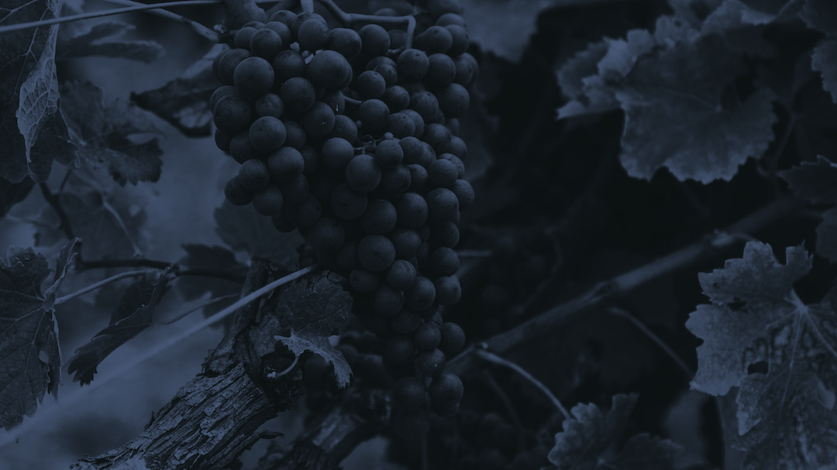
MEMBERS FAVOURITES
WHITES
< HOME

Slide 18
MEMBERS
FAVOURITES
WHITES
CANTINA RAUSCEDO
FRIULI, ITALY
ST. FRANCIS
CALIFORNIA, USA
STAETE LANDT
MARLBOROUGH, NZ
ELK COVE
OREGON, USA
VACHERON
LOIRE VALLEY, FRANCE
< HOME

Slide 19
1 bottle
$36
6 bottles
216
12 bottles
$432
MEMBERS
FAVOURITES
WHITES
CANTINA RAUSCEDO
FRIULI, ITALY
ST. FRANCIS
CALIFORNIA, USA
STAETE LANDT
MARLBOROUGH, NZ
ELK COVE
CANTINA RAUSCEDO, PINOT GRIGIO, FRIULI, ITALY
OREGON, USA
VACHERON
STRAW YELLOW WITH COPPERY REFLECTIONS. MIXTURE OF FRUITY PEAR SCENTS AND ALMOND. FULL-BODIED FLAVOUR, SMOOTH, REMINISCENT OF RIPE FRUIT. IDEAL WITH VEGETABLES AND WHITE MEAT.
LOIRE VALLEY, FRANCE
< HOME

Slide 20
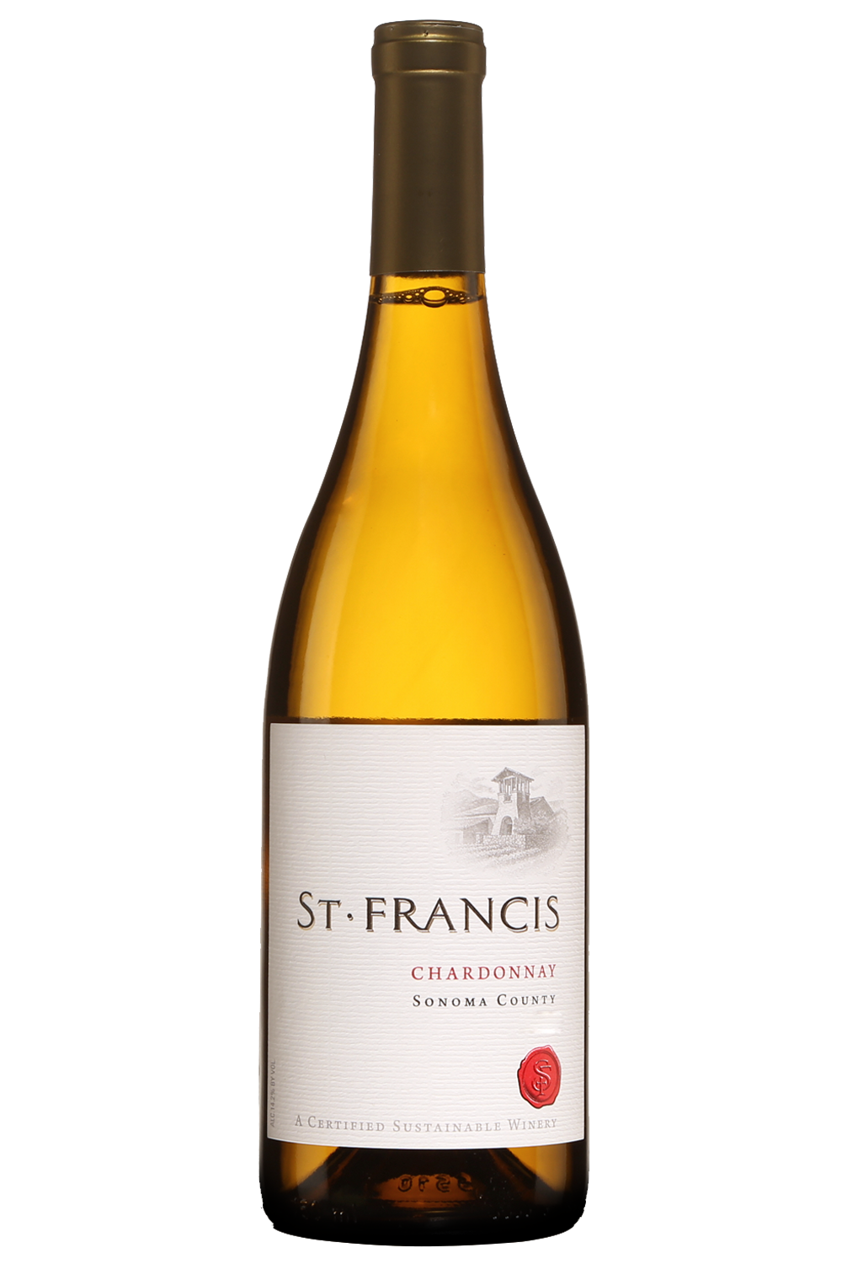
1 bottle
$40
6 bottles
$240
12 bottles
$480
MEMBERS
FAVOURITES
WHITES
CANTINA RAUSCEDO
FRIULI, ITALY
ST. FRANCIS
CALIFORNIA, USA
STAETE LANDT
MARLBOROUGH, NZ
ELK COVE
ST. FRANCIS, CHARDONNAY, SONOMA COUNTY, CALIFORNIA
OREGON, USA
VACHERON
THIS ELEGANT AND REFRESHING CHARDONNAY BURSTS WITH BRIGHT FLAVOURS AND AROMAS OF FRESH-PICKED PEAR, JUICY FUJI APPLE, LEMON ZEST AND GRAHAM CRACKER. A CREAMY MOUTHFEEL GREETS A TOUCH OF MINERALITY ON THE LONG, CRISP FINISH.
LOIRE VALLEY, FRANCE
< HOME

Slide 21
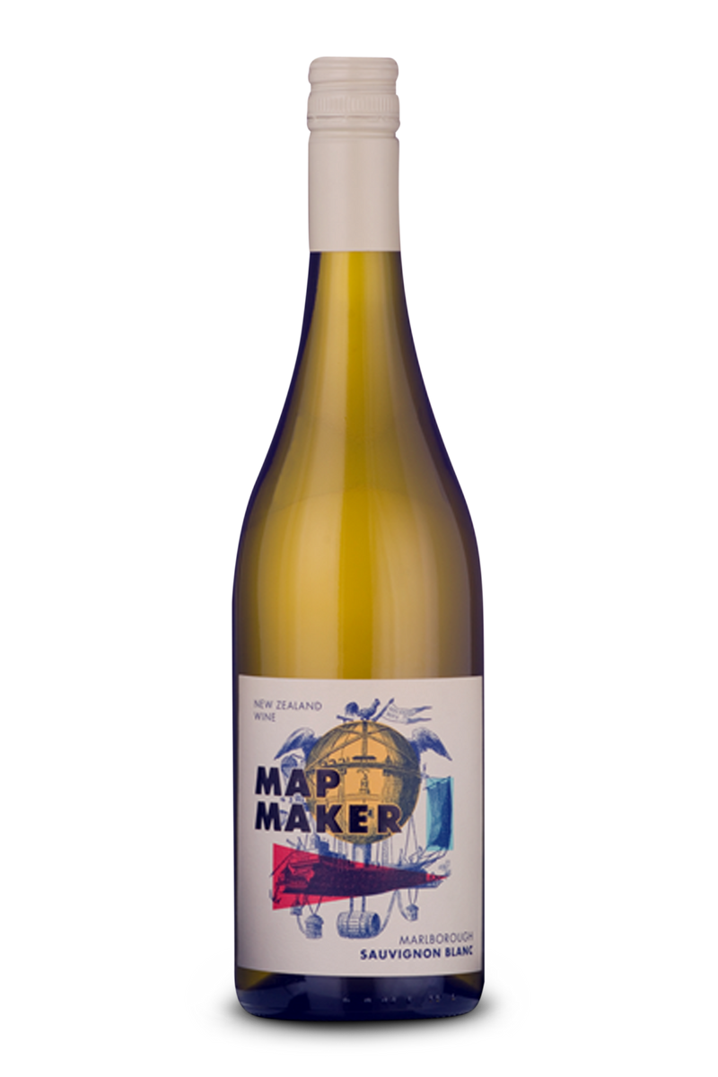
1 bottle
$40
6 bottles
$240
12 bottles
$480
MEMBERS
FAVOURITES
WHITES
CANTINA RAUSCEDO
FRIULI, ITALY
ST. FRANCIS
CALIFORNIA, USA
STAETE LANDT
MARLBOROUGH, NZ
ELK COVE
STAETE LANDT, MAP MAKER, SAUVIGNON BLANC, MARLBOROUGH
OREGON, USA
VACHERON
A PERFECT EXAMPLE OF A LUXURIOUSLY CLASSIC MARLBOROUGH SAUVIGNON BLANC. INTENSELY AROMATIC WITH ATTRACTIVE HERBS AND STONY NOTES. A CREAMY DRY, TANGY SAUVIGNON BLANCE WITH GREEN CAPSICUM, LIME ZEST, GOOSEBERRY AND SUBTLE TROPICAL FRUIT AND PASSIONFRUIT FLAVOURS. A LIGHT AND REFRESHING WINE WITH PURITY AND ENERGY.
LOIRE VALLEY, FRANCE
< HOME

Slide 22
1 bottle
$44
6 bottles
$264
12 bottles
$528
MEMBERS
FAVOURITES
WHITES
CANTINA RAUSCEDO
FRIULI, ITALY
ST. FRANCIS
CALIFORNIA, USA
STAETE LANDT
MARLBOROUGH, NZ
ELK COVE
ELK COVE, PIKE ROAD, CHARDONNAY, WILLAMETTE VALLEY, OREGON
OREGON, USA
VACHERON
PIKE ROAD CHARDONNAY HAS DELICATE TROPICAL NOTES OF PINEAPPLE AND GUAVA MIXED WITH LEMON CURD AND HINTS OF OAK, LEMONGRASS, AND A LONG, SEAMLESS FINISH.
LOIRE VALLEY, FRANCE
< HOME

Slide 23
1 bottle
$68
6 bottles
$408
12 bottles
$816
MEMBERS
FAVOURITES
WHITES
CANTINA RAUSCEDO
FRIULI, ITALY
ST. FRANCIS
CALIFORNIA, USA
STAETE LANDT
MARLBOROUGH, NZ
ELK COVE
VACHERON, SANCERRE, LOIRE VALLEY, FRANCE
OREGON, USA
VACHERON
FULL-BODIED, VERY ELEGANT, BALANCED AND FRUIT INTENSE, WITH MINERAL AND PHENOLIC GRIP. IT HAS A LONG AND POWERFUL FINISH. WITH THE VINEYARD HAVING EQUAL PARTS FLINT AND CHALK SOILS, THE SAUVIGNON BLANC HAS A NERVOUS EDGE AND JUICY CORE OF CITRUS FRUIT. THE AROMATIC FINISH REVEALS MANGO, CASSIS AND MINERAL FLAVOURS. ENJOY WITH SALADS WITH FRESH GOAT CHEESE, OYSTERS OR SHELLFISH.
LOIRE VALLEY, FRANCE
< HOME

Slide 24
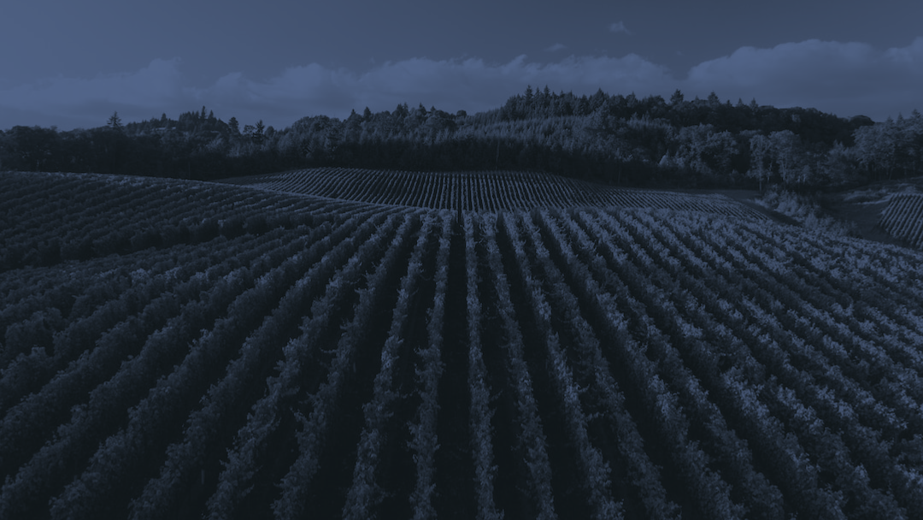
AMANDA’S PICKS
REDS
< HOME

Slide 25
AMANDA’S
PICKS
REDS
ECHEVERRIA
CENTRAL VALLEY, CHILI
CA’VIOLA
PIEMONTE, ITALY
RUST EN VREDE
SOUTH AFRICA
MOLLYDOOKER
AUSTRALIA
< HOME

Slide 26
1 bottle
$40
6 bottles
$240
12 bottles
$480
AMANDA’S
PICKS
REDS
ECHEVERRIA
CENTRAL VALLEY, CHILI
CA’VIOLA
PIEMONTE, ITALY
RUST EN VREDE
SOUTH AFRICA
ECHEVERRIA, CARMENERE, CENTRAL VALLEY, CHILI
MOLLYDOOKER
AUSTRALIA
WITH GENTLE TANNINS, THIS FLAVOURSOME CARMENERE COMBINES INTENSE AROMAS OF RASPBERRIES AND CHERRIES WITH RIPE RED BELL PEPPER AND HINTS OF BLACK PEPPER. SMOOTH AND VELVETY, IT IS WELL BALANCED, WITH SPICE AND BERRY FRUIT MIRRORED ON THE PALATE.
< HOME

Slide 27
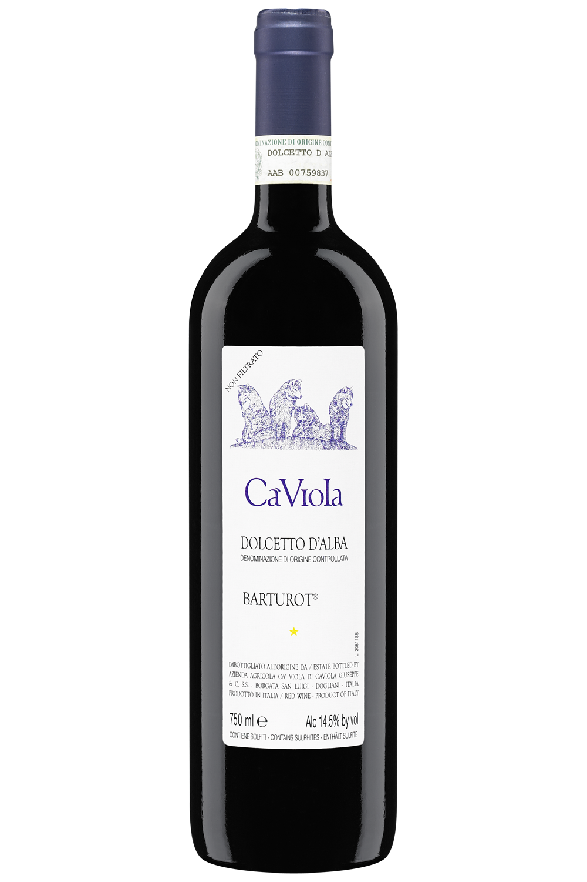
1 bottle
$42
6 bottles
$252
12 bottles
$504
AMANDA’S
PICKS
REDS
ECHEVERRIA
CENTRAL VALLEY, CHILI
CA’VIOLA
PIEMONTE, ITALY
RUST EN VREDE
SOUTH AFRICA
CA’VIOLA, BARTUROT, DOLCETTO D’ALBA, PIEMONTE, ITALY
MOLLYDOOKER
AUSTRALIA
RUBY RED WITH NOTES OF VIOLETS ON THE NOSE LEADING INTO CHERRY AND EARTH NOTES. VERY APPROACHABLE IN ITS YOUTH.
< HOME

Slide 28
1 bottle
$86
6 bottles
$516
12 bottles
$1032
AMANDA’S
PICKS
REDS
ECHEVERRIA
CENTRAL VALLEY, CHILI
CA’VIOLA
PIEMONTE, ITALY
RUST EN VREDE
RUST EN VREDE, ESTATE, STELLENBOSCH, SOUTH AFRICA
SOUTH AFRICA
MOLLYDOOKER
DARK FRUIT AND ROASTED SPICES ARE BACKED UP BY A RICH DARK CHOCOLATE LINE, WITH SUBTLE VANILLA AROMAS. THE DARK FRUIT AND SPICY LICORICE AROMAS FOLLOW THROUGH BEAUTIFULLY FROM THE NOSE. THIS FULL-BODIED WINE HAS GREAT STRUCTURE AND LENGTH, WITH A SEAMLESSLY INTEGRATED MID-PALATE AND A LONG, DRY FINISH.
63% CABERNET SAUVIGNON, 28% SHIRAZ, 9% MERLOT.
AUSTRALIA
< HOME

Slide 29
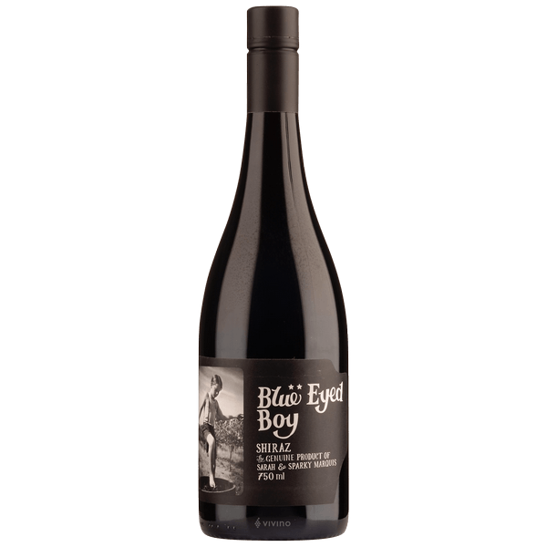
1 bottle
$110
6 bottles
$660
12 bottles
$1320
AMANDA’S
PICKS
REDS
ECHEVERRIA
CENTRAL VALLEY, CHILI
CA’VIOLA
PIEMONTE, ITALY
RUST EN VREDE
MOLLYDOOKER, BLUE EYED BOY, SHIRAZ, MCLAREN VALE, AUSTRALIA
SOUTH AFRICA
MOLLYDOOKER
AUSTRALIA
RICH, RIPE AND EXPLOSIVE, THIS SHIRAZ DISPLAYS VIBRANT BLUEBERRY, PLUM AND NOTES OF DARK CHOCOLATE. THE VOLUPTUOUS PALATE OF BLUE AND BLACKBERRIES IS LAYERED WITH COFFEE, VANILLA CREAM AND LICORICE SPICE. A BEAUTIFULLY DYNAMIC AND BALANCED WINE, WITH A ROUND AND CREAMY FINISH, THE BLUE-EYED BOY EXCEEDS ALL EXPECTATIONS.
< HOME

Slide 30
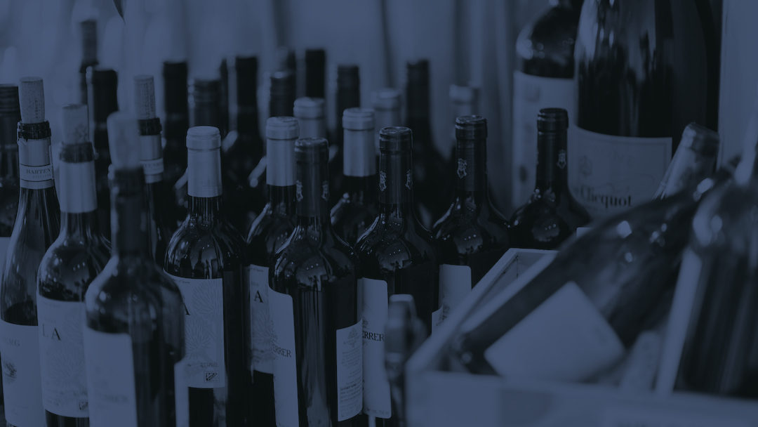
AMANDA’S PICKS
WHITES
< HOME

Slide 31
AMANDA’S
PICKS
WHITES
HANDPICKED
AUSTRALIA
DOISY DAENE
BORDEAUX, FRANCE
CLOSSON CHASE
PRINCE EDWARD COUNTY, ONTARIO
< HOME

Slide 32
1 bottle
$44
6 bottles
$264
12 bottles
$528
AMANDA’S
PICKS
WHITES
HANDPICKED
AUSTRALIA
DOISY DAENE
BORDEAUX, FRANCE
HANDPICKED, CHARDONNAY, YARRA VALLEY, AUSTRALIA
CLOSSON CHASE
PRINCE EDWARD COUNTY, ONTARIO
THIS WHITE OFFERS BOUNCY MELON AND CITRUS FRUITS FOLLOWED BY QUIETER NOTES OF HONEYED NUTS, TOASTY OAK, VANILLA AND SALINE. THE PERKY FRUIT IS HARNESSED BY SLIPPERY TEXTURE AND A BIT OF OAK INFLUENCE, PARTICULARLY ON THE FINISH. A FULL- TO MEDIUM-BODIED CHARDONNAY THAT SHOWS RESTRAINT, MAKING IT EXCEPTIONALLY FOOD FRIENDLY AND ALSO CAPABLE OF AGING THROUGH 2030.
< HOME

Slide 33
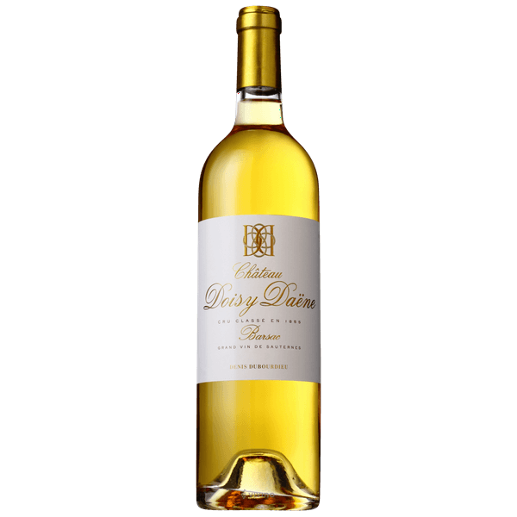
1 bottle
$74
6 bottles
$444
12 bottles
$888
AMANDA’S
PICKS
WHITES
HANDPICKED
AUSTRALIA
DOISY DAENE
BORDEAUX, FRANCE
DOISY DAENE, BARSAC, BORDEAUX, FRANCE
CLOSSON CHASE
PRINCE EDWARD COUNTY, ONTARIO
DOISY DAENE HAS SERIOUSLY INTENSE NOTES OF PINEAPPLE UPSIDE-DOWN CAKE, RIPE APRICOTS AND LEMON MARMALADE WITH HINTS OF ACACIA HONEY, PARAFFIN WAX, ORANGE BLOSSOMS AND PRESERVED GINGER PLUS A WAFT OF MARZIPAN. THE PALATE IS RICH, UNCTUOUS AND BOLDLY DECADENT, FEATURING LAYER UPON LAYER OF EXOTIC FRUITS AND SPICES, FINISHING WIT THAT SIGNATURE FRESHNESS. A POWERHOUSE!
< HOME

Slide 34
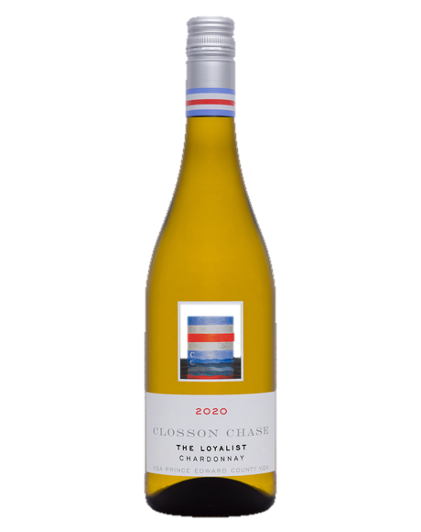
1 bottle
$40
6 bottles
$240
12 bottles
$480
AMANDA’S
PICKS
WHITES
HANDPICKED
AUSTRALIA
DOISY DAENE
BORDEAUX, FRANCE
CLOSSON CHASE
CLOSSON CHASE, LOYALIST, CHARDONNAY, PRINCE EDWARD COUNTY, ONTARIO
PRINCE EDWARD COUNTY, ONTARIO
CITRUS, WHITE FLOWERS AND UNDER-RIPE CANTALOUPE OPEN ON THE NOSE, WITH GRANNY SMITH APPLE AND KAFFIR LIME FILLING IN THE EDGES. FIRM AND CRISP WITH BRIGHT ACIDITY, AMPLE FRUIT CARRIES THROUGH TO A STONE SALTY FINISH. IMPRESSIVE LENGTH WITH GREAT MINERALITY. MADE WITH 100% LOCALLY SOURCED FRUIT.
< HOME

Slide 35
AMANDA’S PICKS
SPARKLING
< HOME

Slide 36
AMANDA’S
PICKS
SPARKLING
SCAR OF THE SEA
CALIFORNIA
< HOME

Slide 37
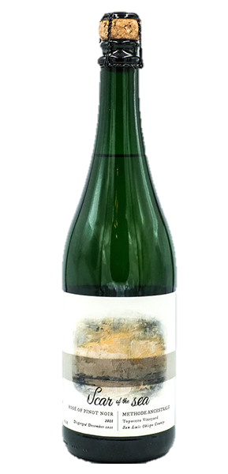
1 bottle
$84
6 bottles
$504
12 bottles
$1008
AMANDA’S
PICKS
SPARKLING
SCAR OF THE SEA
CALIFORNIA
SCAR OF THE SEA, PINOT NOIR ROSE, METHODE ANCESTRALE, CALIFORNIA
PALE PINK IN THE GLASS, THIS PET-NAT POPS WITH LOVELY AROMAS OF STRAWBERRY, COTTON CANDY, LIGHT CHALK AND CITRUS SPRAY. THERE’S A DELICATE, SATISFYING MOUSSE ON THE SIP, WHERE BUBBLEGUM FLAVOURS ARE CUT BY EUREKA LEMON PITH, PROVING FRESH AND INVIGORATING.
< HOME

Slide 38
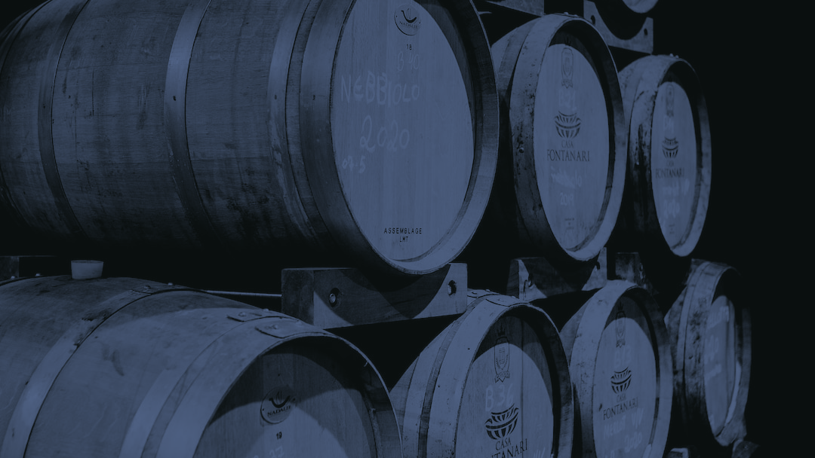
JESSE’S PICKS
REDS
< HOME

Slide 39
JESSE’S
PICKS
REDS
HERAS CORDON
RIOJA, SPAIN
FRANCOIS BUFFET
BURGUNDY, FRANCE
CHATEAU MONTROSE
BORDEAUX, FRANCE
< HOME

Slide 40
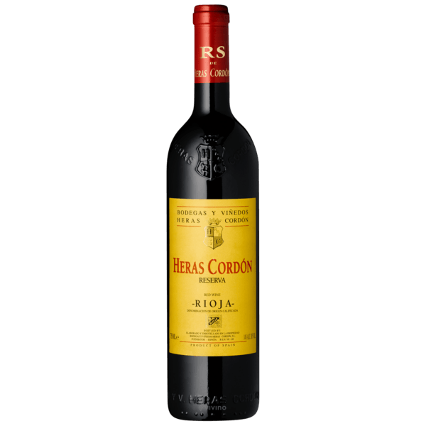
1 bottle
$64
6 bottles
$384
12 bottles
$768
JESSE’S
PICKS
REDS
HERAS CORDON
RIOJA, SPAIN
FRANCOIS BUFFET
BURGUNDY, FRANCE
CHATEAU MONTROSE
HERAS CORDON, RESERVA, RIOJA, SPAIN
BORDEAUX, FRANCE
HERAS CORDON RESERVA 2015 IS AN IMPRESSIVE TEMPRANILLO-DRIVEN FULL-BODIED RED BLEND WITH SOME MAZUELO AND GRACIANO ALL SOURCED FROM THE RIOJA WINE REGION. JUICY AROMAS OF RED BERRY, CHERRY, CASSIS, GRILLED HERBS AND SPICE GREETS THE NOSE WITH SAME CONCENTRATED PALATE. ACIDITY IS IN THE BALANCE AND TANNINS ARE SILKY. DRINK OR HOLD.
< HOME

Slide 41
1 bottle
$68
6 bottles
$408
12 bottles
$816
JESSE’S
PICKS
REDS
HERAS CORDON
RIOJA, SPAIN
FRANCOIS BUFFET
BURGUNDY, FRANCE
FRANCOIS BUFFET, PASSETOUTGRAINS, PINOT NOIR/GAMAY, BURGUNDY, FRANCE
CHATEAU MONTROSE
BORDEAUX, FRANCE
FAMILY WINERY FROM THE VILLAGE OF VOLNAY WITH MORE THAN 300 YEARS OF WINE PRODUCTION TRADITION. A BLEND OF PINOT NOIR & GAMAY, LIGHT RUBY IN COLOUR WITH GARNET HIGHLIGHTS. THIS LOVELY BOURGOGNE ROUGE SHOWS STARTLING PURITY OF FRUIT COMBINED WITH A RACY, JUICY TEXTURE AND LIVELY FINISH. ALL GRAPES ARE HAND-HARVESTED, DESTEMMED AND FERMENTED TRADITIONALLY, WITH AGING IN OLD OAK BARRELS FOR ABOUT 18 MONTHS.
< HOME

Slide 42
1 bottle
$270
6 bottles
$1620
12 bottles
$3240
JESSE’S
PICKS
REDS
HERAS CORDON
RIOJA, SPAIN
FRANCOIS BUFFET
BURGUNDY, FRANCE
CHATEAU MONTROSE
CHATEAU MONTROSE, ST. ESTEPHE, BORDEAUX, FRANCE
BORDEAUX, FRANCE
THIS BIG, TANNIC WINE IS POWERFUL AND CONCENTRATED. IT HAS SOMETHING OF THE CLASSIC SEVERITY OF A WINE FROM THIS ESTATE, BUT THAT’S MITIGATED BY THE RIPE, GENEROUS BLACKBERRY FRUITINESS AND THE FINAL FRESHNESS OF A 2012. A GREAT SUCCESS, TO DRINK
FROM 2022.
< HOME

Slide 43
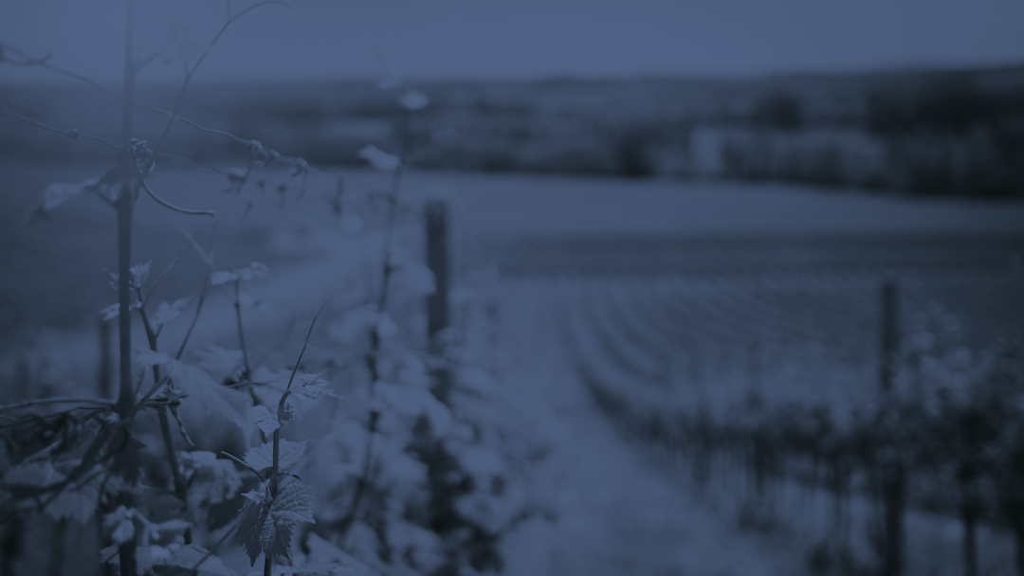
JESSE’S PICKS
WHITES
< HOME

Slide 44
JESSE’S
PICKS
WHITES
MARY TAYLOR
LOIRE VALLEY, FRANCE
CAVE SPRING
NIAGARA PENINSULA
JEAN-LOUIS
RHONE, FRANCE
< HOME

Slide 45
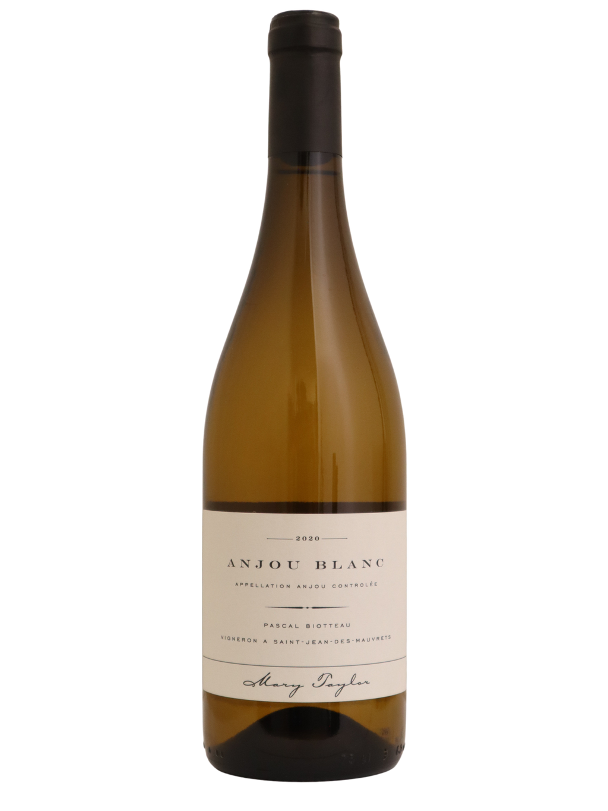
1 bottle
$38
6 bottles
$228
12 bottles
$456
JESSE’S
PICKS
WHITES
MARY TAYLOR
LOIRE VALLEY, FRANCE
CAVE SPRING
NIAGARA PENINSULA
JEAN-LOUIS
MARY TAYLOR, ANJOU, LOIRE VALLEY, FRANCE
RHONE, FRANCE
IN THIS CHENIN BLANC THERE IS THIS HONEYED AND YELLOW APPLE FRUIT FORWARDNESS THAT TAKES OVER THE AROMATIC FRONT. THIS IS FOLLOWED BY FLESHINESS AND SUCCULENCE LIKE BITING INTO A RIPE AND TART STONE FRUIT, A PEACH PER SE THOUGH IN CHENIN TERMS ITS REALLY QUITE DRY. GOOD SHINE AND ACID STRENGTH PROPELS THE WINE FORWARD AND AS ANJOU BLANC IT SUCCEEDS WITH FLYING COLURS. DRINK 2023-2025.
< HOME

Slide 46
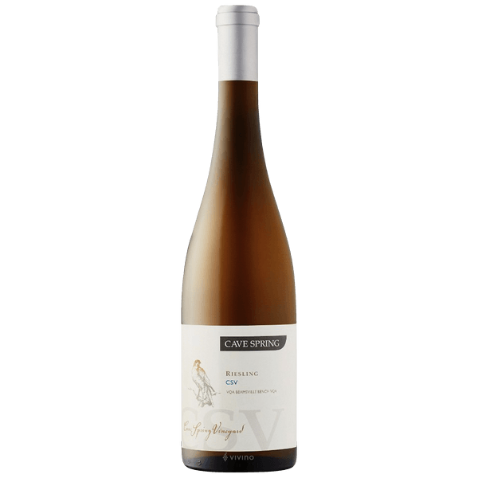
1 bottle
$44
6 bottles
$264
12 bottles
$528
JESSE’S
PICKS
WHITES
MARY TAYLOR
LOIRE VALLEY, FRANCE
CAVE SPRING
NIAGARA PENINSULA
JEAN-LOUIS
CAVE SPRING, CSV, RIESLING, NIAGARA PENINSULA
RHONE, FRANCE
IT’S DRY AND FRUITY, RIPER WITH MORE ALCOHOL THAN THE PREVIOUS VINTAGE, SO MORE FORWARD AND ACCESSIBLE AS A RESULT. A MIX OF CITRUS FRUIT AND LEMON PEEL HIGHLIGHTS FILL THE PALATE, WITH JUST A FAINT SUGGESTION OF GIN-LIKE BOTANICAL HERBS. IT’S A FINE EFFORT, MORE SUITABLE FOR NEAR-TERM DRINKING THAN LONG-TERM CELLARING.
< HOME

Slide 47
1 bottle
$126
6 bottles
$756
12 bottles
$1512
JESSE’S
PICKS
WHITES
MARY TAYLOR
LOIRE VALLEY, FRANCE
CAVE SPRING
NIAGARA PENINSULA
JEAN-LOUIS
JEAN-LOUIS CHAVE, SELECTION, HERMITAGE, RHONE, FRANCE
RHONE, FRANCE
RIPE AND ENTICING IN FEEL, WITH A WAXY-EDGED CORE OF CREAMED YELLOW APPLE, NECTARINE AND MIRABELLE PLUM NOTES, INFUSED LIBERALLY WITH WARM BRIOCHE AND TOASTED MACADAMIA NUT ACCENTS, ALL WHILE MAINTAINING CUT AND FOCUS THROUGH THE FINISH. DRINK NOW THROUGH 2030.
< HOME

